Slide 1
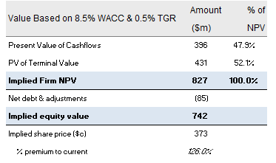
Provide an investment recommendation
Email to management
Greetings of the day, So as we got the news of the fire set up in the firm, and on your request we revised our model then the valuation as a decrease a little bit will respect to safety concerns. Also thef fire that was caused a by a human error due is lack of presence at the given time , also the worker had been removed from the site
Net present value based on perpetuity growth method
Preliminary valuation
Revised valuation (post-fire)
Value Based on 8.5% WACC & 0.5% TGR | Amount ($m) | % of NPV
Present Value of Cash flows | 409 | 50.9%
PV of Terminal Value | 394 | 49.1%
Implied Firm NPV | 803 | 100.0%
Net debt as of Mar-20E | (85)
Implied equity value | 718
Implied offer share price (c) | 361
% premium to current | 118.8%
Source: Company Business Plan (January 2020); Equity research; J.P. Morgan analysis
1

